Slide 1

Advanced Design Patterns

Slide 2
Advanced Design Patterns
Understanding advanced object-oriented design patterns in PHP including Decorator, Observer, and Prototype, and how to implement them in real-world applications.

Slide 3
Decorator Pattern
is a structural pattern that allows adding new behaviors to objects dynamically by placing them inside special wrapper objects, called decorators.
Notes:
https://refactoring.guru/design-patterns/decorator/php/example

Slide 4
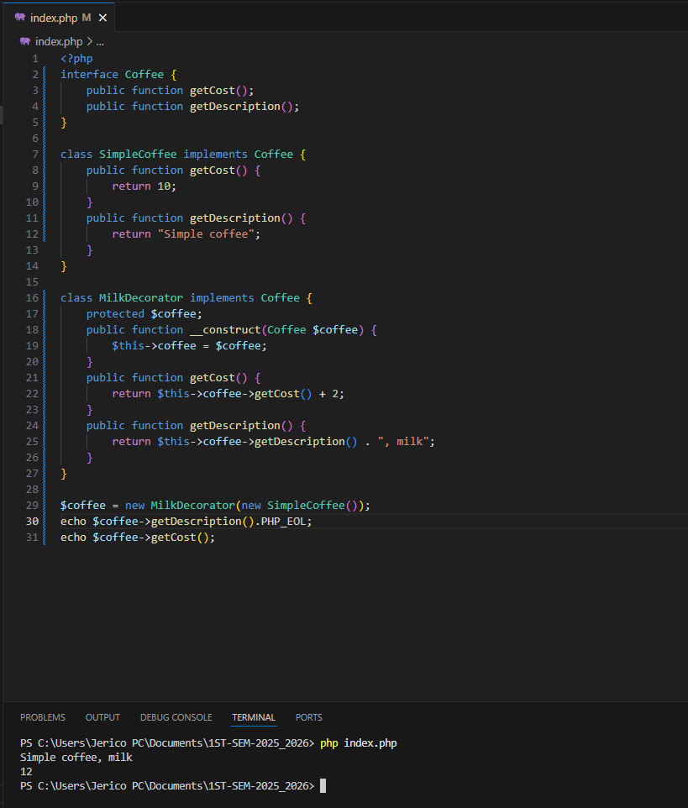
Decorator Pattern - Example
Notes:
Interface: Coffee
Defines the basic structure any coffee must follow:
public function getCost(); public function getDescription();
2. Concrete Class: SimpleCoffee
Implements the base coffee:
getCost() => returns 10 getDescription() => returns "Simple coffee"
3. Decorator Class: MilkDecorator
Adds extra functionality (milk) to any coffee:
Takes a Coffee object in the constructor.
Adds +2 to cost.
Adds ", milk" to the description.
$coffee = new MilkDecorator(new SimpleCoffee());
This wraps the SimpleCoffee inside the MilkDecorator.
Output:
echo $coffee->getDescription(); // Simple coffee, milk
Why it's useful:
You can keep layering more features (like sugar, cream, etc.) without changing the original SimpleCoffee class. It's scalable and clean — each add-on is a new decorator.
Let me know if you want to add more decorators like SugarDecorator or WhippedCreamDecorator.

Slide 5
Observer Pattern - Meaning
is a behavioral design pattern that allows some objects to notify other objects about changes in their state.

Slide 6
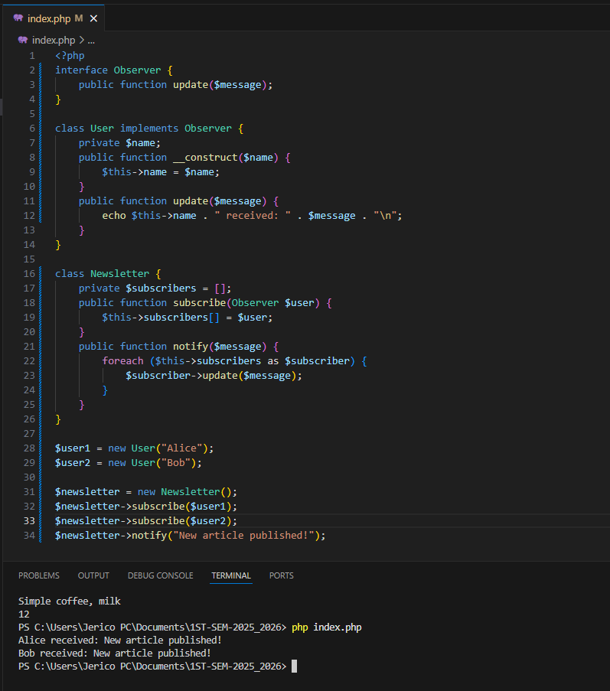
Observer Pattern - Example
Notes:
Example: In a blog system, when a new article is posted, all subscribers (observers) receive an email notification.

Slide 7
Prototype Pattern - Meaning
The Prototype Pattern lets you create new objects by copying an existing object, known as the prototype, instead of creating from scratch.

Slide 8
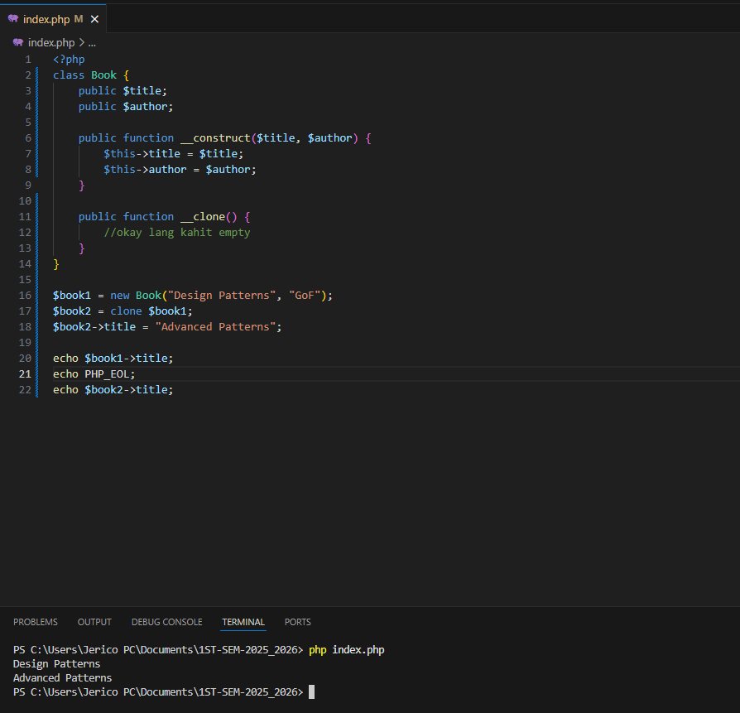
Prototype Pattern - Example

Slide 9
Practical Implementation in PHP
Use these patterns to improve code modularity, flexibility, and reuse in larger PHP projects such as CMS, e-commerce platforms, and custom frameworks.

